Slide 1
Independent STUDY
Review - 2018

Slide 2
Agenda
VIRTUAL COMPANION
Introduction
Literature Review
Research Paper
ALEXA TUTORIAL +
GREETINGS SKILL
DIABETES – VIRTUAL ASSISTANT
Introduction
Study Paper
Calorie Count
Challenges & References

Slide 3
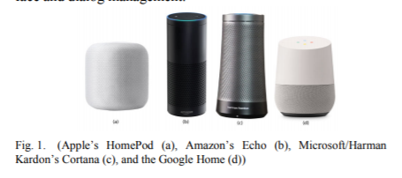
Virtual Personal Assistants (VPAs)
Artificial intelligence (AI) is the realization of natural dialogue between humans and machines
Dialogue systems also known as interactive conversational systems
Dialogue system is used to establish – Virtual Personal Assistants (VPAs)
VPAs – Microsoft’s Cortana, Apple’s Siri, Amazon Alexa, Google Assistant and Facebook’s M
Applications - business enterprises, education, government, healthcare, and entertainment
Reference: https://ieeexplore.ieee.org/document/8301638/

Slide 4
Technologies - VPAs
Google Assistant – Deep Neural Network
Microsoft’s Cortana – Microsoft Azure Machine learning studio
Facebook Messenger M - machine-learning algorithms with contextual memory
Amazon Alexa - Advanced deep learning functionalities of automatic speech recognition (ASR) to convert for converting speech to text, and natural language understanding (NLU) to recognize the intent of the text
Reference: https://ieeexplore.ieee.org/document/8301638/

Slide 5
Chatbots + Cognitive APIs = Personalized Experience
Why?
The interaction between users and bots is mostly free-form, so bots need to understand language naturally and contextually
How?
Determine what users want, to identify concepts and entities in a given sentence, and ultimately to allow your bots to respond with the appropriate action
Generate business value from unstructured data
Feed data into an intelligent algorithm that can analyze, understand correlations and learn from the data to automatically improve its intelligence
Major Players:
Microsoft and IBM – provide APIs

Slide 6
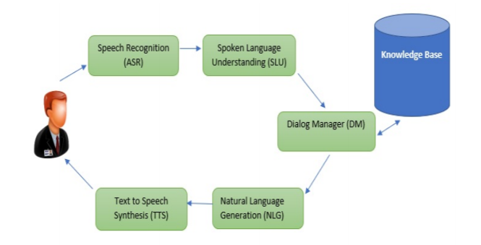
General Dialogue Management

Slide 7
Literature Review
You and your bot – A new kind of relationship
IBM Robotic Roommate
Emotional connection with robot
Palro – Robot in Japan
Emily – Talks about end of life wishes

Slide 8
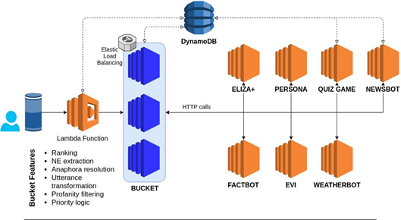
Architecture Diagram

Slide 9
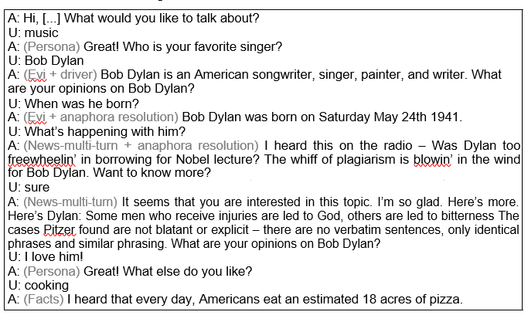
Sample Utterance

Slide 10
Behavioral Utterances
Example: An interlocutor can give various answers to the question “How are you?”
There could be three main scenarios: Good, Normal and Bad
In each of the scenarios the robot’s task is to ask the interlocutor to tell about this in more detail.
Complex Part - To determine now how the dialogue will develop further.
An elderly person can tell what a wonderful dream he has dreamed, how well he feels, or can start complaining. For such cases, the robot must be provided with words of support that will allow a person to speak out.

Slide 11
Diabetics
Specific conversation

Slide 12
Standard Assistive
Home automation
Product centric
Assist with Patient Information Leaflet (PIL) or Package Insert (PI)
Patient Centric
Capture Progress
Reminders
Injectable therapy
Personal response to their medications
Outcomes on treatment

Slide 13
Features – Diabetes Companion
Memory: Remember not only the name of the interlocutor plus his/her habits, likes and dislikes
Reactions: Switch complicated and difficult topics of a conversation, such as: illness or death to a positive course, so that the interlocutor could enjoy the communication
Reminder: To take medicine or call relatives and friends
Search for relevant and interesting information: That is to provide it with an automatic function to independently search for answers in Google

Slide 14
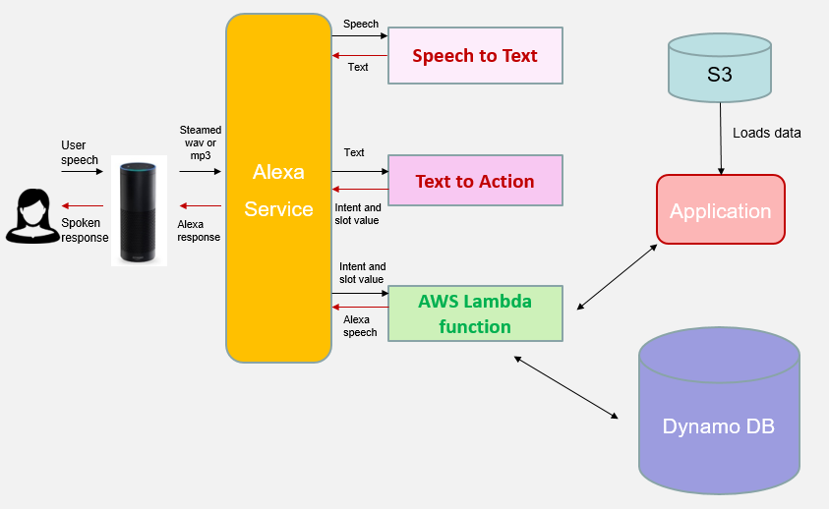
Architecture Diagram – Calorie Count

Slide 15
Calorie Count – Sample Utterances
Request: Alexa, ask “nutri lookup” ”how many calories are in <food item>”
Ex: Alexa, ask nutri lookup how many calories are in butter salted
Response: 100 grams of <food item> contain <number> calories.
Ex: 100 grams of butter salted contain 717 calories.

Slide 16
Challenges
Decide upon the factors to start conversation on – not more than 20 topics.
Memorize the context for cohesive dialogue.
Start the dialogue with ease - create dialogue templates

Slide 17
Accomplishment
I feel significantly proud in doing this project in a short time with a great objective to help the diabetic people in need.
Even though we have not done everything we have planned, we are proud of whatever we have successfully implemented in the short span of time we had.
Gained the knowledge of writing Alexa skill which could be used to improve quality of life

Slide 18
References
“Reversing Type-2 Diabetes and insulin” http://www.shareguide.com/diabetes.html
“Diabetes Information Technology: Designing Informatics Systems to Catalyze Change in Clinical Care” https://www.ncbi.nlm.nih.gov/pmc/articles/PMC2771488/
“Programmable APIs” https://www.programmableweb.com/category/health/apis?category=19988

